Slide 1



Curriculum Mapping Webinar
Curriculum Mapping Webinar: New Challenges and Opportunities
Batoul Senhaji-Tomza, Pharm.D, MPH
Assistant Dean, Curriculum & Associate Professor,
Touro College of Pharmacy
                Keith Yoshizuka
                PharmD, MBA, JD, FCSHP
                Asst. Dean for Administration
                Chair, Social, Behavioral, and Administrative Sciences Touro University California - College of Pharmacy
Touro College & University System Assessment Webinar
November 5th, 2019

Slide 2
Program Objectives
Program Objectives
Understand Curriculum Mapping Expectations and Requirements
Define Curriculum Mapping purposes and goals
Discuss Suggested Best Practices for efficient Curriculum mapping process
Identify curriculum mapping outcomes as part of the continuous quality improvement cycle

Slide 3

The Chinese Character for Change = Danger + Opportunity

Slide 4
What is Curriculum Mapping?
required in the curriculum and document where in the program that it was covered
Curricular Mapping is a process where specific learning objectives are tracked throughout the curriculum and milestones are identified, assessed, and categorized on a progression from introduction to mastery.
  Elements
    Introduction

Slide 5
Where to start?
Generally, the curriculum is driven by the requirements of the accrediting body
Academic institutions are free to embellish, emphasize, and introduce materials other than that which is required, but we must first meet the basics
Admittedly, a curriculum utilizing a 2+2 format has limited ability to cover more than the basics of what is required.

Slide 6
Past Expectations/Requirements
Curricular Mapping: New Challenges/New Opportunities
What we used to do
  Identify what was required in the curriculum and document where in the program that it was covered
Past Process
  Identify curriculum requirements
  Document curriculum coverage location requirements/expectations
  It is no longer sufficient to just show that it was covered. The expectation is now to demonstrate progression in level of competency
  Elements
    Introduction

Slide 7
Current Expectations/Requirements
document where in the program that it was covered
Documenting coverage alone is no longer sufficient..
Must now demonstrate progression in the level of competency
  Levels of competency
    Introduction
    Reinforcement
    Mastery

Slide 8
Current Expectations/Requirements
document where in the program that it was covered
  Level of Detail Required
    Drilling down from where the subject matter is covered in the specific class or lecture, to sometimes the specific slide

Slide 9
Current Expectations/Requirements
document where in the program that it was covered
Measuring student progression
Tagging exam questions to specific level of progression to monitor student progress
  Introduction
  Reinforcement
  Mastery

Slide 10
Curriculum Mapping Purpose/Uses
Curricular Mapping: New Challenges/New Opportunities
Outline
This is a dynamic process
Curricular mapping captures state of the curriculum
  Tracks alignment of program Learning Outcome objectives and goals
  Tracks alignment with course objectives
  Shows spatial relationships of a curriculum and facilitates in developing and integrating elements of the curriculum
Challenges/New Opportunities
Outline

Slide 11
Curriculum Mapping Purpose/Uses
Curricular Mapping: New Challenges/New Opportunities
Outline
It is a guide for curriculum committees
  To track gaps;
  To eliminate unnecessary redundancies and duplications, unless reinforcement is warranted
It can be used as a guide on instructional design and assessment
s

Slide 12
Curriculum Mapping Purpose/Uses
Curricular Mapping: New Challenges/New Opportunities
Outline
It opens up opportunity for dialogue between departments
Documents that accreditation standards are being met
Ultimately serves as a tool to develop, review, improve and refine curricula while supporting curricular transparency
    Mastery
: New Challenges/New Opportunities

Slide 13
Curriculum Mapping Benefits
Curricular Mapping: New Challenges/New Opportunities
Outline
Documents student learning process
  What is taught, where and when
Ensures alignment with learning outcomes
Identifies gaps and redundancies
Facilitates faculty communication
: New Challenges/New Opportunities

Slide 14
Curriculum Mapping Benefits
Curricular Mapping: New Challenges/New Opportunities
Outline
Helps design curricular assessment plan
Promotes creativity and collaboration
Creates a visual compendium of skills and content covered in each course and throughout the curriculum
    Mastery
: New Challenges/New Opportunities

Slide 15
Curriculum Mapping Suggested Process
Curricular Mapping: New Challenges/New Opportunities
1. Clearly define program goals and objectives
2. Perform a review of any curricular requirements/standards to identify the elements
3. Present identified elements to department chairs, then to the faculty to identify where these topics are covered

Slide 16
Curriculum Mapping Suggested Process
Curricular Mapping: New Challenges/New Opportunities
4. Identify level of coverage
    Introductory
    Reinforcement
    Mastery level.
    5. Capture expected knowledge or skill level of each course

Slide 17
Curriculum Mapping Suggested Process (continued)
Curricular Mapping: New Challenges/New Opportunities
6. Capture and define instructional methods utilized to teach the outcomes in the course (case studies; group work; lecture; written assignment; etc.)
7. Capture how the specific outcome is assessed in the course

Slide 18
Process “Must’s”
Curricular Mapping: New Challenges/New Opportunities
ALL elements MUST BE presented to ALL faculty
  several items may be taught in different courses/disciplines by different faculty
  conducive to stratifying introduction, reinforcement, and mastery.
  It may also be used as a conduit for communication between departments to coordinate efforts and eliminate redundancies unless reinforcement is warranted
Outline

Slide 19
Process “Must’s”
Curricular Mapping: New Challenges/New Opportunities
  It may also be an opportunity for cross education among faculty;
    E.g. Clinical faculty may educate basic science faculty about changes in practice and how curriculum needs to adapt.: New Challenges/New Opportunities
Outline

Slide 20
What is the ideal level of detail to be captured in a curricular map?
    For accuracy, we recommend identifying where the subject matter is covered in the specific course or lecture, and sometimes down to the specific slide
    We recommend tagging exam questions to the subject matter
    Identify throughout the curriculum where such materials are introduced, reinforced, and ultimately mastered

Slide 21
Curriculum Mapping Suggested Workflow Process Example
Curriculum Committee identifies required elements of the curriculum
Departments identify where the material is covered and perform initial mapping
Curriculum committee reviews and validates the mapping
Curriculum committee analyzes the mapping material and identifies possible redundancies and gaps

Slide 22
Curriculum Mapping Suggested Workflow Process Example
  5. Results and recommendations are shared with Departments chairs and faculty to solicit additional feedback if necessary
  6. Departments adjust curriculum accordingly
Curriculum Changes Documented at the CC
Mapping Process Performed annualy as part of the Curricular CQI

Slide 23
Suggested Process
Review Curricular Requirements to define necessary outcomes /elements to be covered
Departments work independently to identify elements in each course/ lecture
Faculty in each department identifies the elements in their lectures
Curriculum Committee Reviews and validates map
Curricular Mapping: New Challenges/New Opportunities
sufficient to just show that it was covered. The expectation is now to demonstrate progression in level of competency
  Elements
    Introduction
    Reinforcement
    Mastery
  To what level of detail?
    Depending on the program, I would recommend identifying where the subject matter is covered in the specific class or lecture, and maybe down to the specific slide
    How is it measured? Exam questions should be tagged with the specific element so that student progress can be monitored
  Purpose
    Dynamic document serving to capture state of the curriculum as well as a guide for the CC to track gaps; healthy vs. unnecessary redundancies etc.
What is required now?
  First, a review of any curricular requirements/standards must be performed to identify the elements
  The identified elements are presented to department chairs, then to the faculty to identify where these topics are covered (to the lecture or even the slide) and identify whether it is introductory, reinforcement, and mastery level.
  The reason ALL elements are presented to ALL faculty, is that we discovered that several items were being taught in different courses by different people, and in several instances, in different disciplines. This is not bad, as it is conducive to stratifying introduction, reinforcement, and mastery. It may also be a conduit for communication between departments (such as basic science and clinical faculty) to coordinate efforts and eliminate redundancies. It may also be an opportunity for clinical faculty to educate basic science faculty about changes in practice (and which things are either changed or not used anymore).
PDSA
  This is an ongoing continuous quality improvement (CQI) process. Through the assessments (this is why it is important to tag the category of the question), we can determine if the student is making satisfactory progress between introduction, reinforcement, and mastery (in several instances, mastery may occur during clinical rotations outside of the didactic environment, so it is important to capture these elements in the clinical assessments of the students).
  Action plans are developed
    If individual students have difficulty making the progression, the specific areas of deficiency will be easier to identify.
    If a significant portion of the class has difficulty making progression, the strategy to revise the didactic approach earlier for the specific elements must be revised.
Process map example for conducting efficient Curriculum Mapping
  Departmental mapping (Course and Exam level mapping)
  Curriculum committee validation of departmental mapping
  Departmental and CC yearly review and mapping as part of the CQI
Conclusion/Questions
Define Program Goals and Objectives
Notes:
Define Program Goals and Objectives

Slide 24
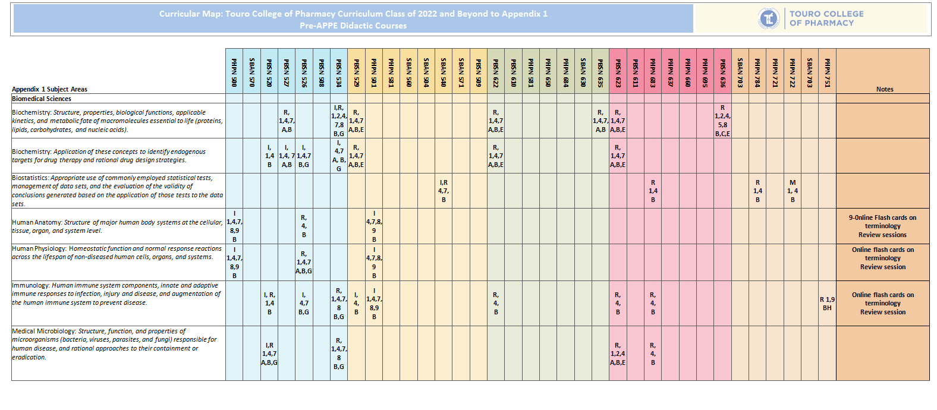
Curricular Map Example
Curricular Mapping: New Challenges/New Opportunities
sufficient to just show that it was covered. The expectation is now to demonstrate progression in level of competency
  Elements
    Introduction
    Reinforcement
    Mastery
  To what level of detail?
    Depending on the program, I would recommend identifying where the subject matter is covered in the specific class or lecture, and maybe down to the specific slide
    How is it measured? Exam questions should be tagged with the specific element so that student progress can be monitored
  Purpose
    Dynamic document serving to capture state of the curriculum as well as a guide for the CC to track gaps; healthy vs. unnecessary redundancies etc.
What is required now?
  First, a review of any curricular requirements/standards must be performed to identify the elements
  The identified elements are presented to department chairs, then to the faculty to identify where these topics are covered (to the lecture or even the slide) and identify whether it is introductory, reinforcement, and mastery level.
  The reason ALL elements are presented to ALL faculty, is that we discovered that several items were being taught in different courses by different people, and in several instances, in different disciplines. This is not bad, as it is conducive to stratifying introduction, reinforcement, and mastery. It may also be a conduit for communication between departments (such as basic science and clinical faculty) to coordinate efforts and eliminate redundancies. It may also be an opportunity for clinical faculty to educate basic science faculty about changes in practice (and which things are either changed or not used anymore).
PDSA
  This is an ongoing continuous quality improvement (CQI) process. Through the assessments (this is why it is important to tag the category of the question), we can determine if the student is making satisfactory progress between introduction, reinforcement, and mastery (in several instances, mastery may occur during clinical rotations outside of the didactic environment, so it is important to capture these elements in the clinical assessments of the students).
  Action plans are developed
    If individual students have difficulty making the progression, the specific areas of deficiency will be easier to identify.
    If a significant portion of the class has difficulty making progression, the strategy to revise the didactic approach earlier for the specific elements must be revised.
Process map example for conducting efficient Curriculum Mapping
  Departmental mapping (Course and Exam level mapping)
  Curriculum committee validation of departmental mapping
  Departmental and CC yearly review and mapping as part of the CQI
Conclusion/Questions

Slide 25
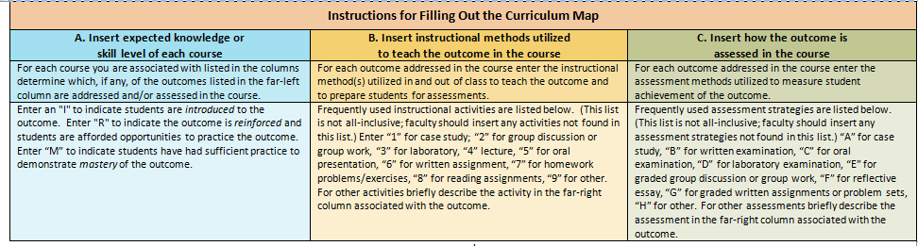
Curricular Map Instruction Example

Slide 26
Continuous Quality Improvement Cycle
Curricular Mapping: New Challenges/New Opportunities
Measure Curricular efficacy using :
  The assessments (tagged exam questions) to help monitor student progress
  To validate whether the student is making satisfactory progress between introduction, reinforcement, and mastery
  Use these results to either help individual students focus on areas for improvement or to identify opportunities for improvement in the curriculum
  identifying where the subject matter is covered in the specific class or lecture, and maybe down to the specific
Notes:
etc.

Slide 27
Translating curriculum mapping into Curricular Quality Improvement
Departments address gaps in the vertical and horizontal alignment of courses
Faculty assess the level of mastery students have achieved in preceding courses and build on specific skills and knowledge
Individual student difficulties will be easier to identify.
Revise the didactic approach if the entire class has difficulty with an identified topic

Slide 28
Conclusion/ Discussion
Effective and sustainable curriculum mapping requires:
  A systematic iterative and reflective approach
  Dedicated and engaged faculty members
  Creativity (centralized vs. decentralized effort)
  Leadership at all levels of the institution Opportunities

Slide 29
Challenges/ Opportunities and Future Directions
Curricular mapping will be difficult for those institutions not used to having clinical and basic science departments working closely together
This is not a one-time endeavor; rather, it is a continuous quality improvement process
This is an opportunity to reduce unnecessary redundancies, and to identify those areas where reinforcement and enhancement are beneficial.

Slide 30

References
Curricular Mapping: New Challenges/New Opportunities
Zelenitsky, S., Vercaigne, L., Davies, N. M., Davis, C., Renaud, R., & Kristjanson, C. Using curriculum mapping to engage faculty members in the analysis of a pharmacy program. American Journal of Pharmaceutical Education, 78(7), (2014).
Al-Eyd, G., Achike, F., Agarwal, M., Atamna, H., Atapattu, D. N., Castro, L., . . . Tenore, A.. Curriculum mapping as a tool to facilitate curriculum development: A new school of medicine experience. BMC Medical Education, 18(1), 18-9. (2018)
Cottrell, S., Hedrick, J. S., Lama, A., Chen, B., West, C. A., Graham, Wright, M. Curriculum mapping: A comparative analysis of two medical school models. Medical Science Educator, 26(1), 169-174. (2016).
Levin, P. F., & Suhayda, R. Transitioning to the DNP: Ensuring integrity of the curriculum through curriculum mapping. Nurse Educator, 43(3), 112-114. (2018).
sufficient to just show that it was covered. The expectation is now to demonstrate progression in level of competency
  Elements
    Introduction
    Reinforcement
    Mastery
  To what level of detail?
    Depending on the program, I would recommend identifying where the subject matter is covered in the specific class or lecture, and maybe down to the specific slide
    How is it measured? Exam questions should be tagged with the specific element so that student progress can be monitored
  Purpose
    Dynamic document serving to capture state of the curriculum as well as a guide for the CC to track gaps; healthy vs. unnecessary redundancies etc.
What is required now?
  First, a review of any curricular requirements/standards must be performed to identify the elements
  The identified elements are presented to department chairs, then to the faculty to identify where these topics are covered (to the lecture or even the slide) and identify whether it is introductory, reinforcement, and mastery level.
  The reason ALL elements are presented to ALL faculty, is that we discovered that several items were being taught in different courses by different people, and in several instances, in different disciplines. This is not bad, as it is conducive to stratifying introduction, reinforcement, and mastery. It may also be a conduit for communication between departments (such as basic science and clinical faculty) to coordinate efforts and eliminate redundancies. It may also be an opportunity for clinical faculty to educate basic science faculty about changes in practice (and which things are either changed or not used anymore).
PDSA
  This is an ongoing continuous quality improvement (CQI) process. Through the assessments (this is why it is important to tag the category of the question), we can determine if the student is making satisfactory progress between introduction, reinforcement, and mastery (in several instances, mastery may occur during clinical rotations outside of the didactic environment, so it is important to capture these elements in the clinical assessments of the students).
  Action plans are developed
    If individual students have difficulty making the progression, the specific areas of deficiency will be easier to identify.
    If a significant portion of the class has difficulty making progression, the strategy to revise the didactic approach earlier for the specific elements must be revised.
Process map example for conducting efficient Curriculum Mapping
  Departmental mapping (Course and Exam level mapping)
  Curriculum committee validation of departmental mapping
  Departmental and CC yearly review and mapping as part of the CQI
Conclusion/Questions
  what level of detail?
    Depending on the program, I would recommend identifying where the subject matter is covered in the specific class or lecture, and maybe down to the specific slide
    How is it measured? Exam questions should be tagged with the specific element so that student progress can be monitored
  Purpose
    Dynamic document serving to capture state of the curriculum as well as a guide for the CC to track gaps; healthy vs. unnecessary redundancies etc.
What is required now?
  First, a review of any curricular requirements/standards must be performed to identify the elements
  The identified elements are presented to department chairs, then to the faculty to identify where these topics are covered (to the lecture or even the slide) and identify whether it is introductory, reinforcement, and mastery level.
  The reason ALL elements are presented to ALL faculty, is that we discovered that several items were being taught in different courses by different people, and in several instances, in different disciplines. This is not bad, as it is conducive to stratifying introduction, reinforcement, and mastery. It may also be a conduit for communication between departments (such as basic science and clinical faculty) to coordinate efforts and eliminate redundancies. It may also be an opportunity for clinical faculty to educate basic science faculty about changes in practice (and which things are either changed or not used anymore).
PDSA
  This is an ongoing continuous quality improvement (CQI) process. Through the assessments (this is why it is important to tag the category of the question), we can determine if the student is making satisfactory progress between introduction, reinforcement, and mastery (in several instances, mastery may occur during clinical rotations outside of the didactic environment, so it is important to capture these elements in the clinical assessments of the students).
  Action plans are developed
    If individual students have difficulty making the progression, the specific areas of deficiency will be easier to identify.
    If a significant portion of the class has difficulty making progression, the strategy to revise the didactic approach earlier for the specific elements must be revised.
Process map example for conducting efficient Curriculum Mapping
  Departmental mapping (Course and Exam level mapping)
  Curriculum committee validation of departmental mapping
  Departmental and CC yearly review and mapping as part of the CQI
Conclusion/Questions

Slide 31
References
Curricular Mapping: New Challenges/New Opportunities
Michael, M., Wilson, C., Jester, D. J., Andel, R., D'Aoust, R., Badana, A. N. S., & Hyer, K. Application of curriculum mapping concepts to integrate multidisciplinary competencies in the care of older adults in graduate nurse practitioner curricula. Journal of Professional Nursing : Official Journal of the American Association of Colleges of Nursing, 35(3), 228-239 (2019)
Onen Bayram, F. E., & Koksal, M. A quantitative curriculum mapping of the faculty of pharmacy of yeditepe university, turkey: A process to assess the consistency of a curriculum with the mission and vision of an institution and national requirements. Pharmacy (Basel, Switzerland), 7(3), (2019).
Sellar, B., Murray, C. M., Stanley, M., Stewart, H., Hipp, H., & Gilbert-Hunt, S.. Mapping an australian occupational therapy curriculum: Linking intended learning outcomes with entry-level competency standards. Australian Occupational Therapy Journal, 65(1), 35-44. (2018)
Sterz, J., Hoefer, S. H., Janko, M., Bender, B., Adili, F., Schreckenbach, T., . . . Ruesseler, M.. Do they teach what they need to? an analysis of the impact of curriculum mapping on the learning objectives taught in a lecture series in surgery. Medical Teacher, 41(4), 417-421. (2019)

Slide 32
Thank You for Joining Us
THANK YOU
FOR JOINING US
^{WeAreTouro}
^{www.Touro.edu}
@
Notes:
Curriculum mapping is essential to curriculum design in maintaining consistency and curricular quality control. This process comes with its own set of challenges, particularly in light of recent changes in accreditory requirements involving tracking and accountability.
This seminar aims to provide an overview of the curricular mapping process, discussing changes, challenges, and opportunities, as well as sharing some of the lessons learned with implementing an efficient and sustainable mapping process

